Slide 1

ML BASED MODEL SOLUTION TO REFINE CAPTCHA
BATCH NO : IOMP03
NAMES & ROLL NO : KOVURU MOUNIKA (227Y1A0597)
P.KAMESWARI LAALITHYA (227Y1A0587)
GUIDE NAME :Dr.SHAIK MAHEBOOB

Slide 2
OBJECTIVE
To develop a non-intrusive, passive ML-based solution to detect bots and prevent DoS/DDoS attacks on UIDAI portals, thereby replacing CAPTCHA and improving user experience.

Slide 3
ABSTRACT
CAPTCHAs are widely used to prevent bots, but they degrade user experience.
This project presents a passive solution that silently collects browser and behavioral data and uses a machine learning model to identify whether the user is human or a bot.
The goal is to provide robust security without user interaction, improving accessibility and speed for all users.

Slide 4
INTRODUCTION
UIDAI portals are critical to delivering Aadhaar services.
CAPTCHAs, though effective, are an inconvenience and create barriers for genuine users.
The solution here proposes a shift towards passive bot detection—observing the user's environment and interaction patterns silently and classifying the user using AI without them having to solve anything.

Slide 5
LITERATURE SURVEY
Google reCAPTCHA :Active challenge-response system.
FingerprintJS :Passive fingerprinting library.
Bot mitigation tools like Cloudflare Bot Management use heuristics and AI.
Academic studies suggest high accuracy in bot detection using interaction metrics and device fingerprinting.

Slide 6
PROBLEM STATEMENT
UIDAI needs to protect Aadhaar portals and backend APIs from automated attacks (DoS/DDoS).
CAPTCHAs are intrusive and harm user experience.
A non-intrusive, passive solution is needed that:
i.Collects browser and environment da
ii.Uses AI/ML to classify user as bot or human
iii.Requires minimal to no interaction

Slide 7
EXISTING SYSTEM (DRAWBACKS)
CAPTCHAs:
Reduce accessibility (especially for elderly and differently abled).
Can be bypassed by bots using OCR or CAPTCHA-solving services.
Interrupt user experience.
Existing passive systems are proprietary and not easily customizable.
Breaks accessibility and user trust

Slide 8
PROPOSED SYSTEM
Frontend (React/TypeScript): Collects environmental and interaction data.
Backend (FastAPI): Hosts a trained machine learning model (Random Forest) to analyze data and respond with predictions.
Fallback: Minimal fallback interaction only if prediction is low-confidence(like moving mouse or scroll)
Pluggable: Easy to integrate with existing UIDAI backend services.

Slide 9
Software and Hardware Requirements
Software:
Python, FastAPI, scikit-learn (Backend)
React + TypeScript (Frontend)
Node.js and npm
Hardware:
Any modern computer
4GB+ RAM
Internet connection for testing and demonstration

Slide 10
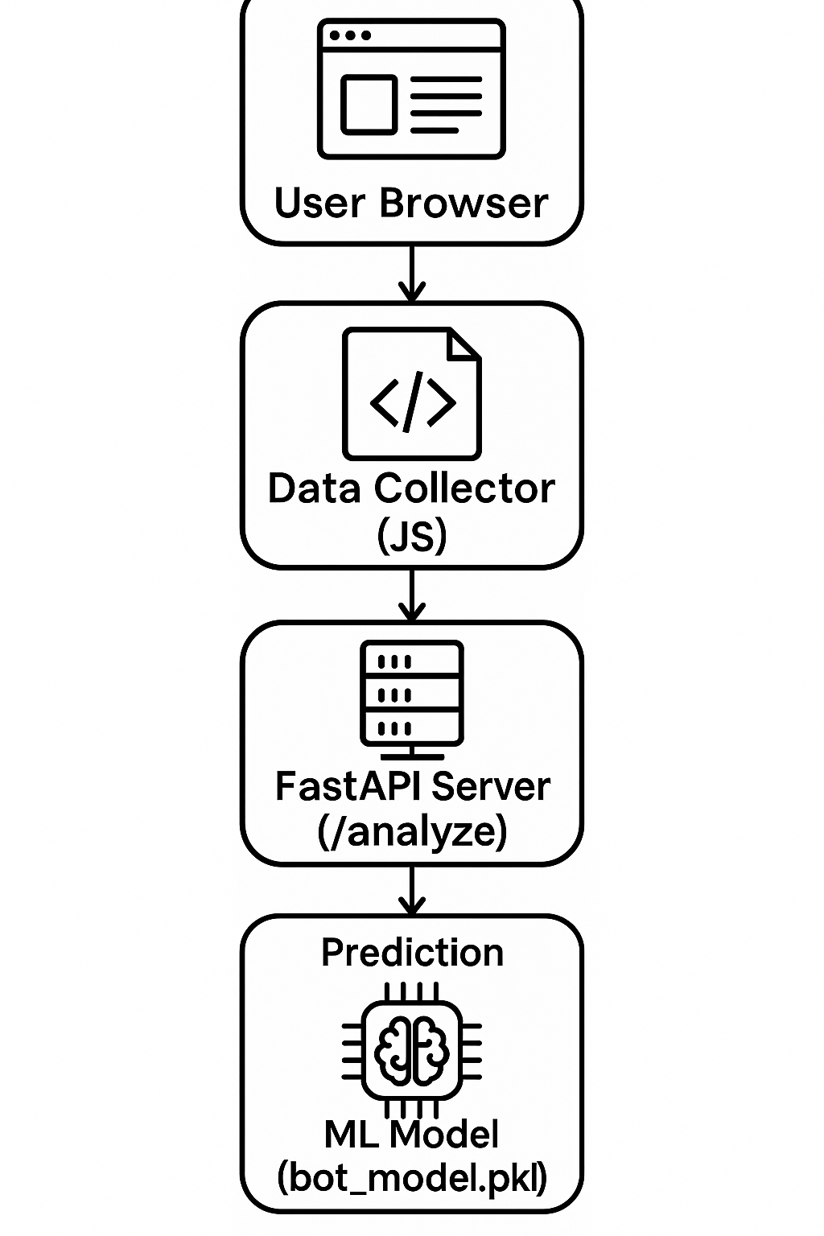
ARCHITECTURE

Slide 11
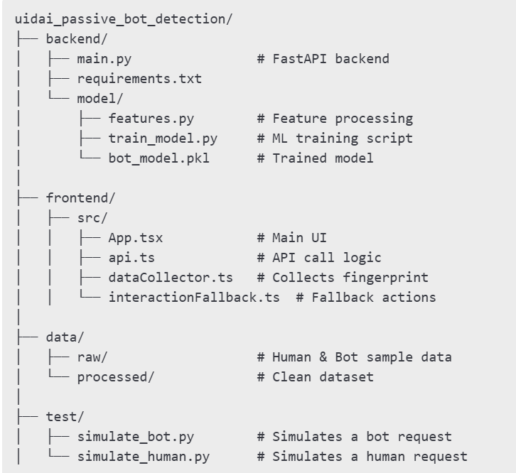
PROJECT STRUCTURE

Slide 12
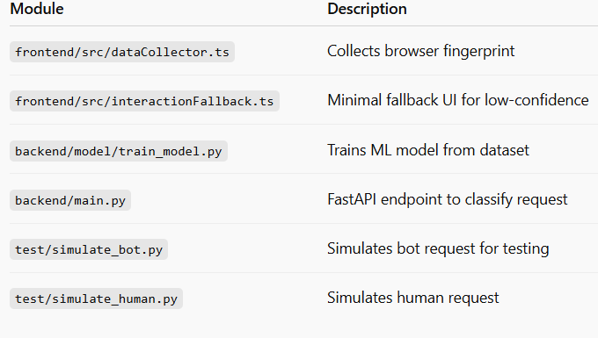
MODULE SPLIT-UP

Slide 13
Model training & API use
Backend Setup
Step-1:Setup Virtual Enviroment and install requirements
Step-2:Train the ML Model
This will save bot_model.pkl

Slide 14
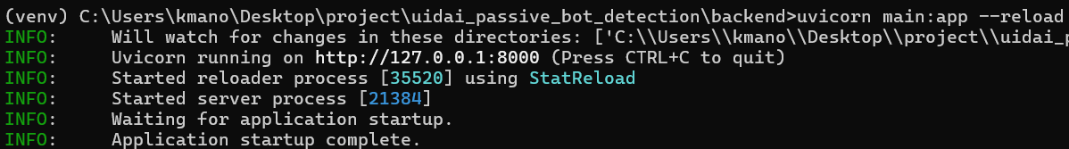

Step-3:Run the Backend Server
if you open the obtained url http://127.0.0.1:8000 it shows this
You can test it with POST Request using http://localhost:8000/analyze in VSCode.

Slide 15
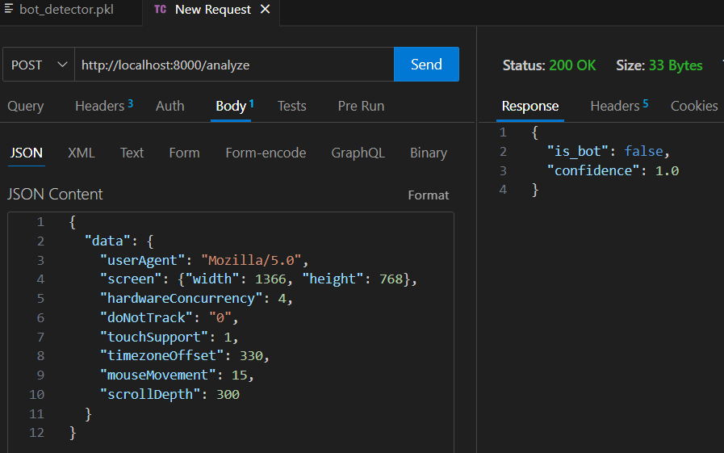

Slide 16
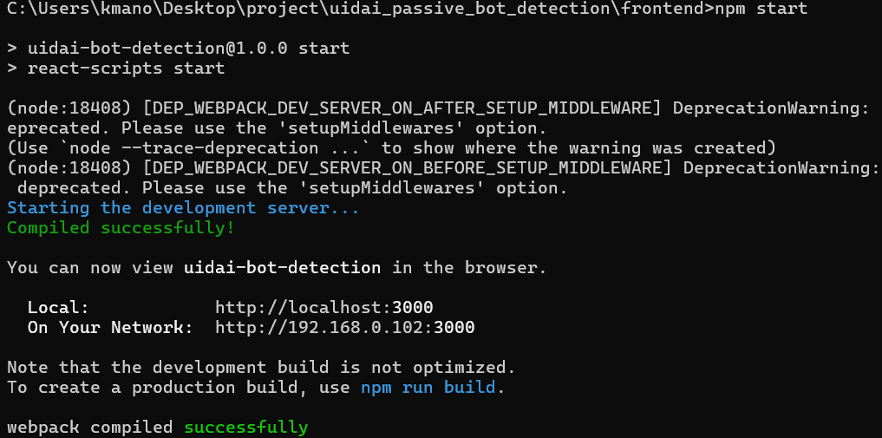
Frontend Setup
This will capture browser fingerprint and send it to the /analyze endpoint and finally displays the output by redirecting to that browser.

Slide 17
Conclusion
This solution achieves passive bot detection without interrupting users.
It improves accessibility and offers a scalable, secure, and privacy-conscious replacement for CAPTCHA.
It is fully customizable and can be integrated with UIDAI systems.

Slide 18
References
UIDAI Challenge Document https://uidai.gov.in
FingerprintJS Documentation https://fingerprint.com
scikit-learn: Machine Learning in Python Pedregosa et al., Journal of Machine Learning Research, 2011 https://scikit-learn.org
FastAPI Documentation Sebastián Ramírez, https://fastapi.tiangolo.com
Google reCAPTCHA Technical Overview https://developers.google.com/recaptcha
Browser Fingerprinting Techniques EFF Panopticlick Project, https://panopticlick.eff.org

Slide 19
THANKYOU

